Slide 1
It doesn't matter if you run a well-established business or you are managing a startup.

Slide 2
It doesn't matter how much of a budget you're working with.

Slide 3
Like it or not, and believe it or not, the main way you can make people become aware of your company's brand,

Slide 4
…and eventually consume the products or services your company offers, is through advertising.

Slide 5
Free Advertising Doesn't Exist

Slide 6
Let's put it this way, you can't be in two places at once.

Slide 7
If you're spending all this time and effort trying to brand and promote your business the ‘free’ way,

Slide 8
…what if you did something else that produces ten times the result?

Slide 9
You Cannot Ignore Facebook Ads

Slide 10
Here’s where my advice for you comes in.

Slide 11
With My Advice…
You will understand why to use Facebook Ads.
You will also know the Downside of Facebook Advertising.
You will find out about the technology behind it.
You will be able to leverage its highly sophisticated "social snooping" and "personal profiling" technology.
You will learn step by step, the different ad opportunities currently available on the Facebook ad platform.

Slide 12
To make it easy, I’ve put together a step-by-step guide that will show you exactly how it’s done...

Slide 13
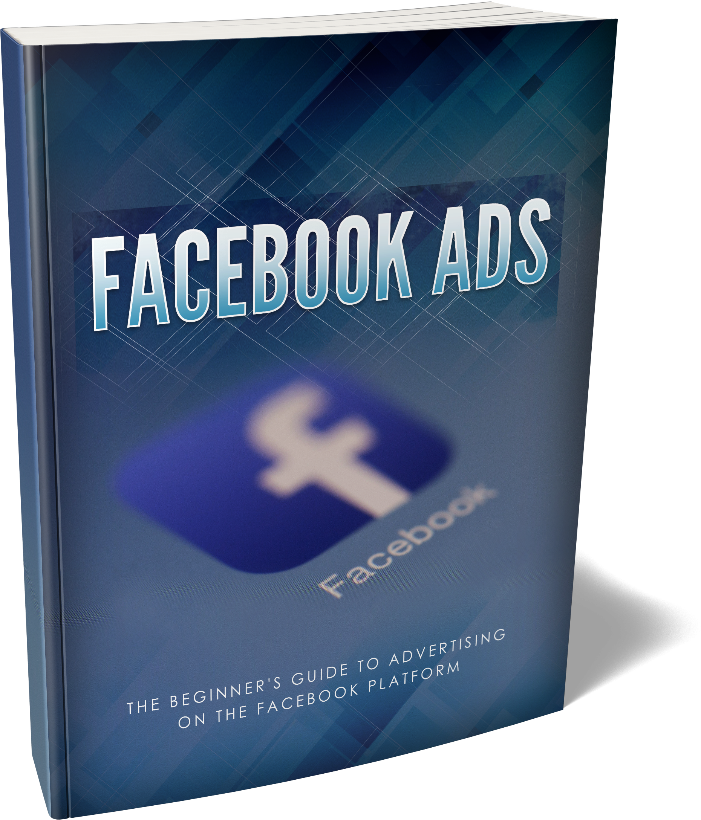
Introducing…

Slide 14
Here’s Just A Quick Preview Of What You’ll Discover Inside...
Why Choose Facebook Ads?
Use the Facebook Ads Manager
The Basics You Need to Know Before Creating Your First Facebook Ad Campaign
Create A Facebook Advertising Campaign
How Does Facebook's Ad System Operate?
Create Your Ad
Monitor Your Campaign Carefully
How to Get Started on Your Facebook Ad Marketing Campaign
Create Your Facebook Page and Account
Effective Facebook Advertising Tips and Ideas

Slide 15
Plus, a whole lot more...

Slide 16
This is the easiest way to actually produce ten times better results with Facebook Ads!

Slide 17
Who Needs This Step-By-Step Guide?

Slide 18
If you answer YES to any of the below, you need this…
You want to produce ten times better results with Traffic Generation.
You want to learn Facebook Advertising the right way.
You want to leverage the highly sophisticated "social snooping" and "personal profiling" technology Mark Zuckerberg brought to the table.
You want to figuratively get in the head of your target audience.
You want to show ads that match the concerns, fears, and needs of your target audience.

Slide 19
Does This Sound Like Exactly What You Need? But maybe your next question is: How Much?

Slide 20
If you were going to hire an expert on this, to show you how it’s done,

Slide 21
you could easily find yourself investing hundreds of dollars for this sort of coaching.

Slide 22
In fact, many people invest hundreds and thousands of dollars to get into coaching programs or attend workshops...

Slide 23
But, you won’t have to invest anywhere near that today.

Slide 24
And it just keeps getting better…

Slide 25
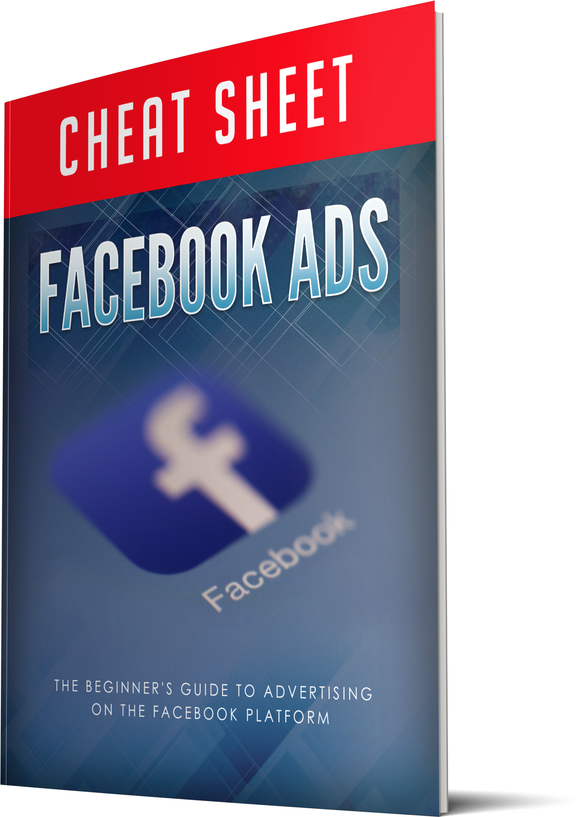
When You Make The Wise Decision To Grab This Today, You’ll Also Get These Fast Action Bonuses…
Fast Action Bonus #1 – Facebook Ads – Cheat Sheet (Valued at $27)

Slide 26

When You Make The Wise Decision To Grab This Today, You’ll Also Get These Fast Action Bonuses…
Fast Action Bonus #2 – Facebook Ads – Mind Map (Valued at $17)

Slide 27
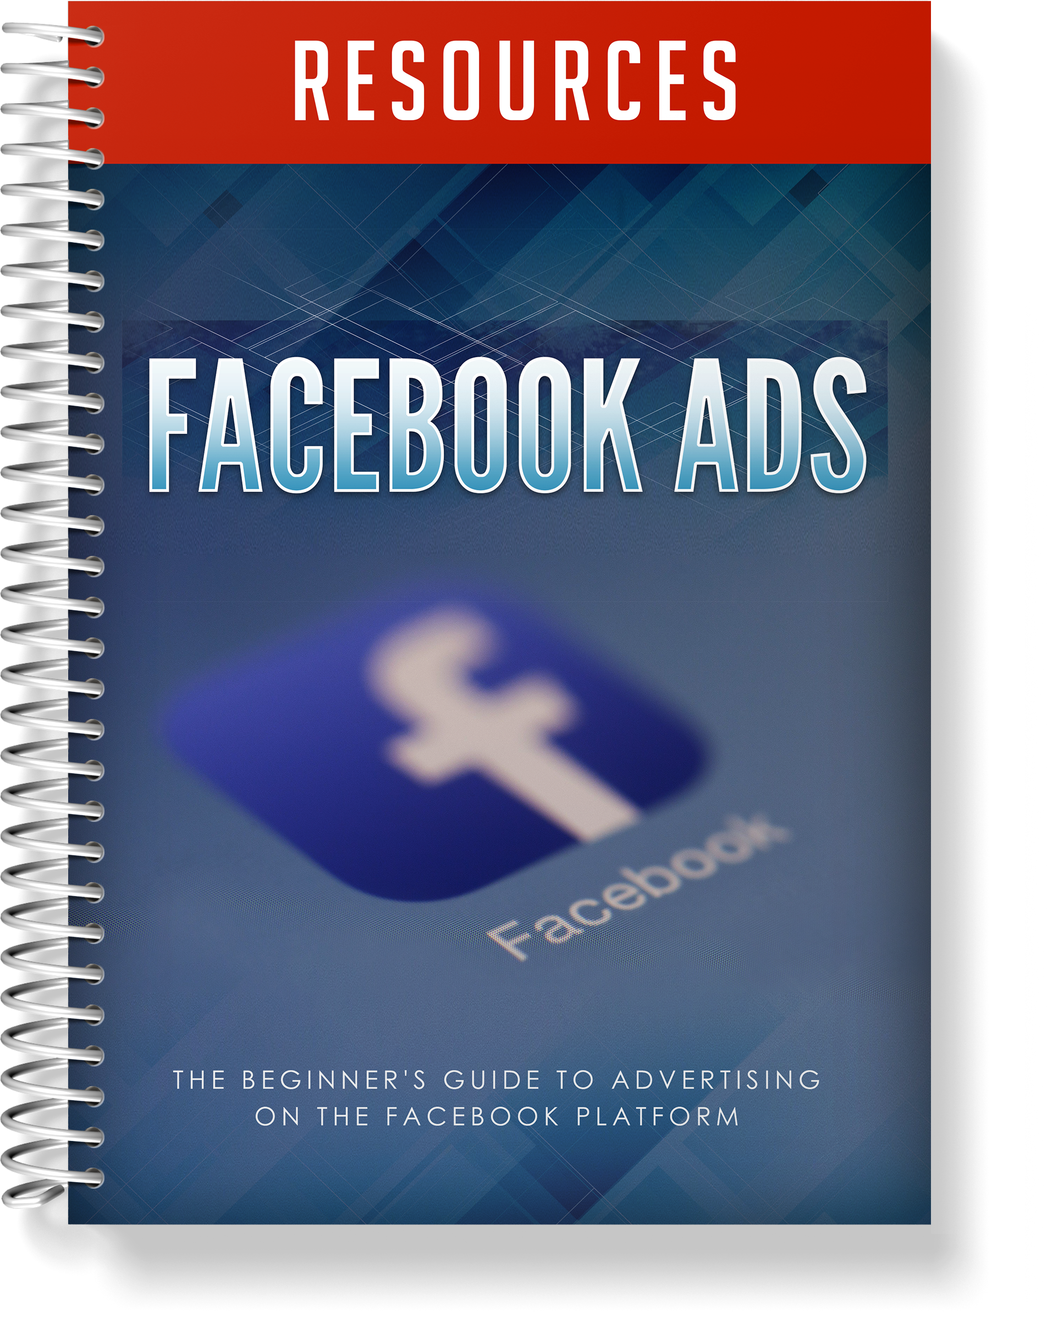
When You Make The Wise Decision To Grab This Today, You’ll Also Get These Fast Action Bonuses…
Fast Action Bonus #3 – Facebook Ads – Resource Guide (Valued at $17)

Slide 28
Try This Guide On MY DIME… There’s No Risk!

Slide 29
There are a lot of people that claim to offer a solution on how to produce better results by using Facebook Ads,

Slide 30
so it’s understandable if you’re a little skeptical.

Slide 31
I can keep telling you just how great my guide is,

Slide 32
but you really need to go through it and see for yourself what it’s all about to know if it’s for you…

Slide 33
That’s why I’m going to give you a FULL 30 days to decide if this is for you…

Slide 34
If for any reason, or no reason at all, you’re not 100% satisfied with what’s inside,

Slide 35
simply send me an email, and I’ll refund every penny of your tiny investment…

Slide 36
No questions asked!

Slide 37
Click The Button Below Now To Get INSTANT ACCESS…

